Slide 1
Concept of Regression
Regression is concerned with specifying the relationship between a single numeric dependent variable (the value to be predicted) and one or more numeric independent variables (the predictors).
From algebra , lines can be defined in a slope-intercept form similar to y = a + bx, where y is the dependent variable and x is the independent variable.
In this formula, the slope b indicates how much the line rises for each increase in x.
The variable a indicates the value of y when x = 0. It is known as the intercept because it specifies where the line crosses the vertical axis.
A regression problem is the problem of determining a relation between one or more independent variables and an output variable which is a real continuous variable, given a set of observed values of the set of independent variables and the corresponding values of the output variable.
    Examples
    Let us say we want to have a system that can predict the price of a used car. Inputs are the car attributes brand, year, engine capacity, mileage, and other information that we believe affect a car’s worth. The output is the price of the car.

Slide 2
The most basic regression model (those that use straight lines) is Linear Regression.
If there is only a single independent variable, this is known as simple linear regression, otherwise it is known as multiple regression. Both of these models assume that the dependent variable is continuous.

Slide 3
Simple Linear Regression
Let x be the independent predictor variable and y the dependent variable. Assume that we have a set of observed values of x and y:
y= a+bx
A simple linear regression model defines the relationship between x and y using a line defined by an equation in the following form: y=a+bx
In order to determine the optimal estimates of a and b, an estimation method known as Ordinary Least Squares (OLS) is used

Slide 4
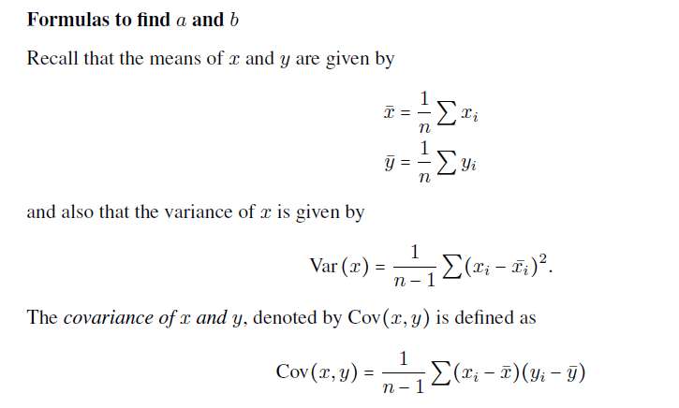
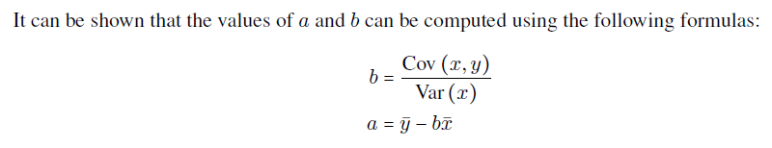

Slide 5
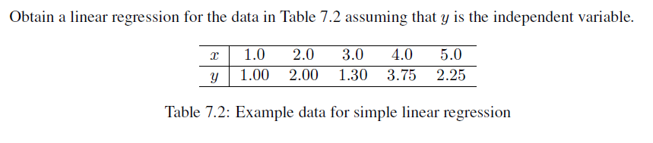
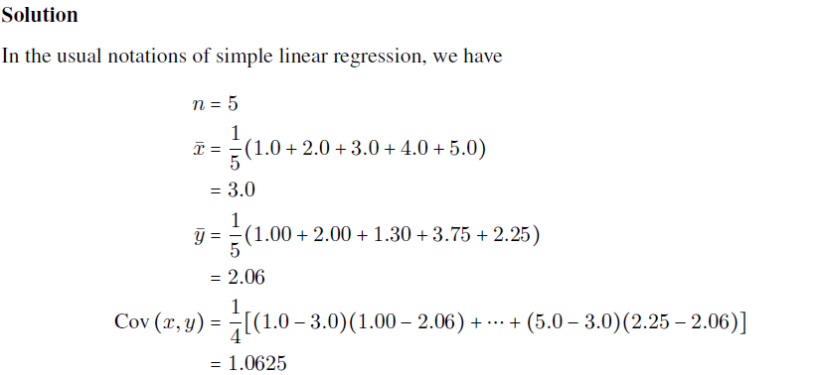
Problem

Slide 6
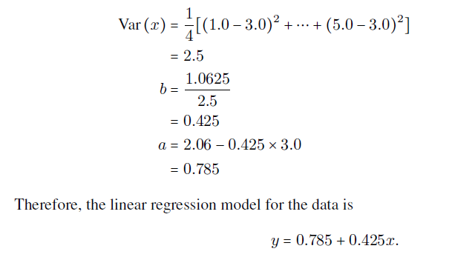

Slide 7
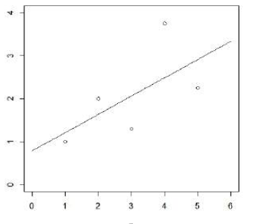

x | 0 | 1 | 2 | 3 | 4 | 5
y | 0.785 | 1.21 | 1.635 | 2.06 | 2.485 | 2.91

